Slide 1
Build-A-Cabin
Build-A-Cabin: It’s like Build-A-Bear except for the fact that it’s not Build-A-Bear, you just get a virtual house with no plumbing or electricity.

Slide 2
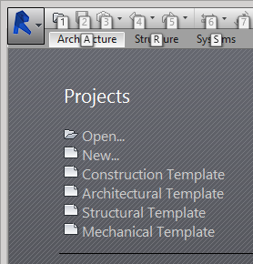
First you need to open up Revit 2015 and select the Architectural Template to start building.

Slide 3
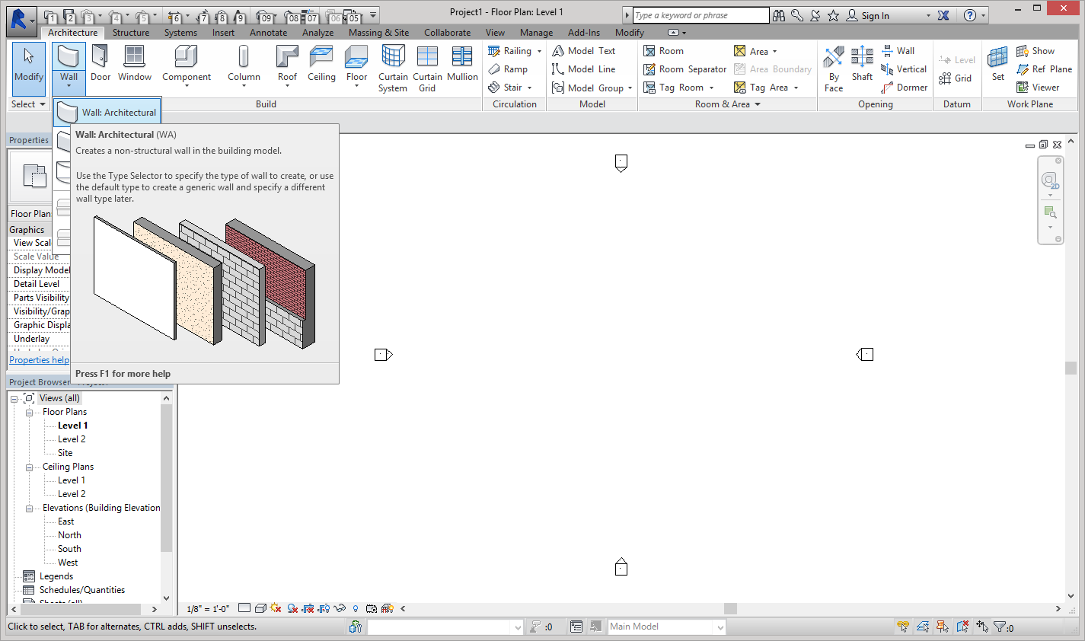
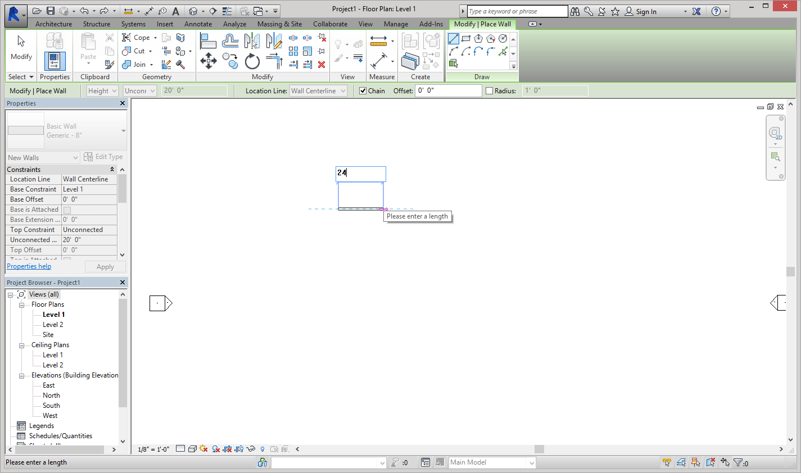
Next select the wall tool under the Architecture Tab. You want to make an architectural wall.
Select a spot on the template and move your mouse to the right a bit and type 24 to get a 24ft wall. You can also just drag the mouse to the right until it says 24.

Slide 4
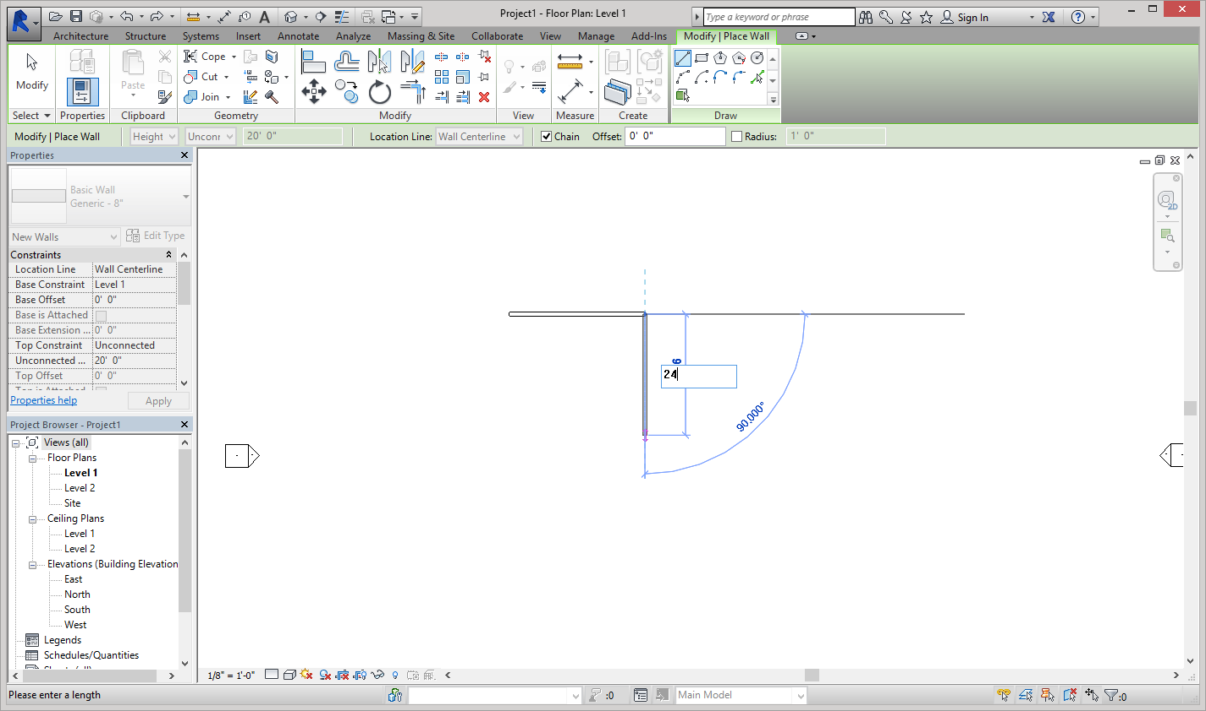
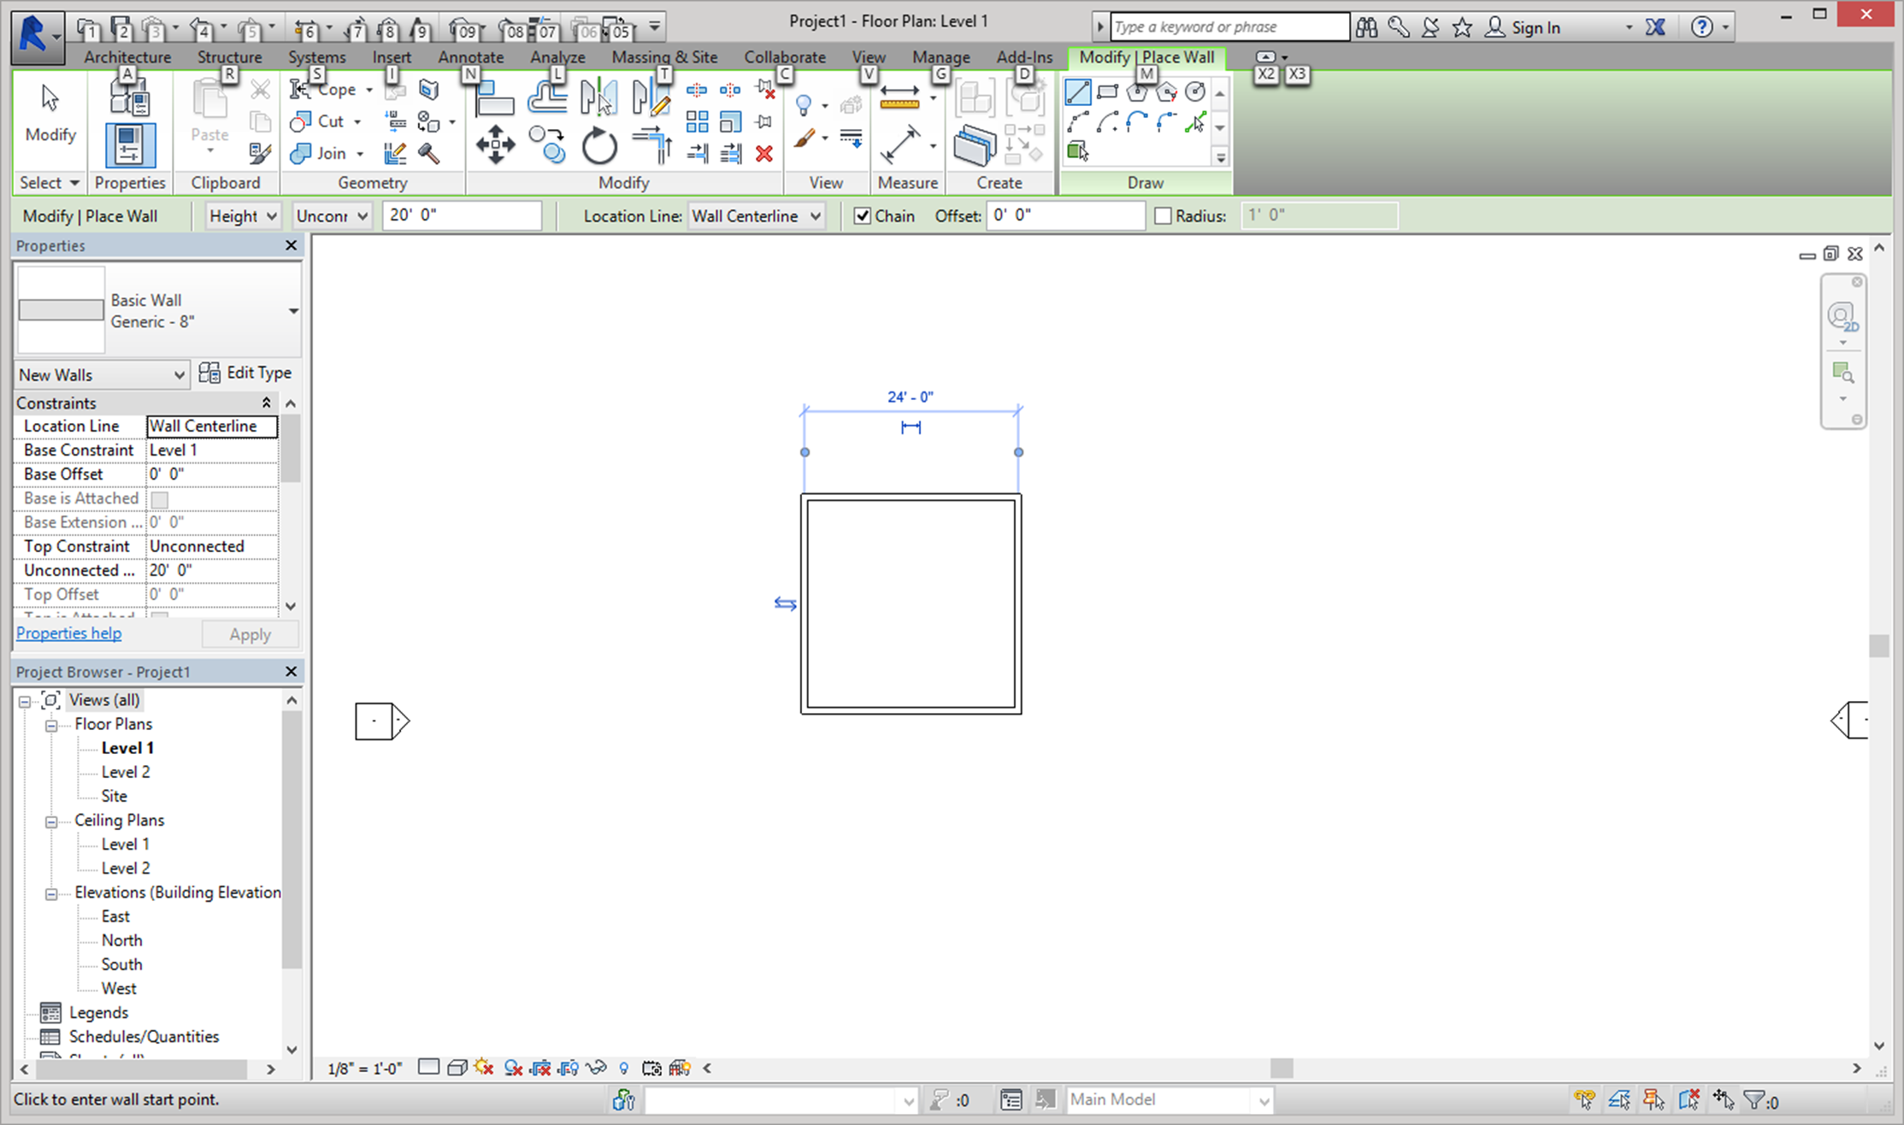
After you create the first wall, move your mouse down and enter 24. Make sure the 90* angle guide appears so that you walls are perpendicular. Do this for the South and West walls.
This is what your exterior walls should look like once you have created all four walls.

Slide 5
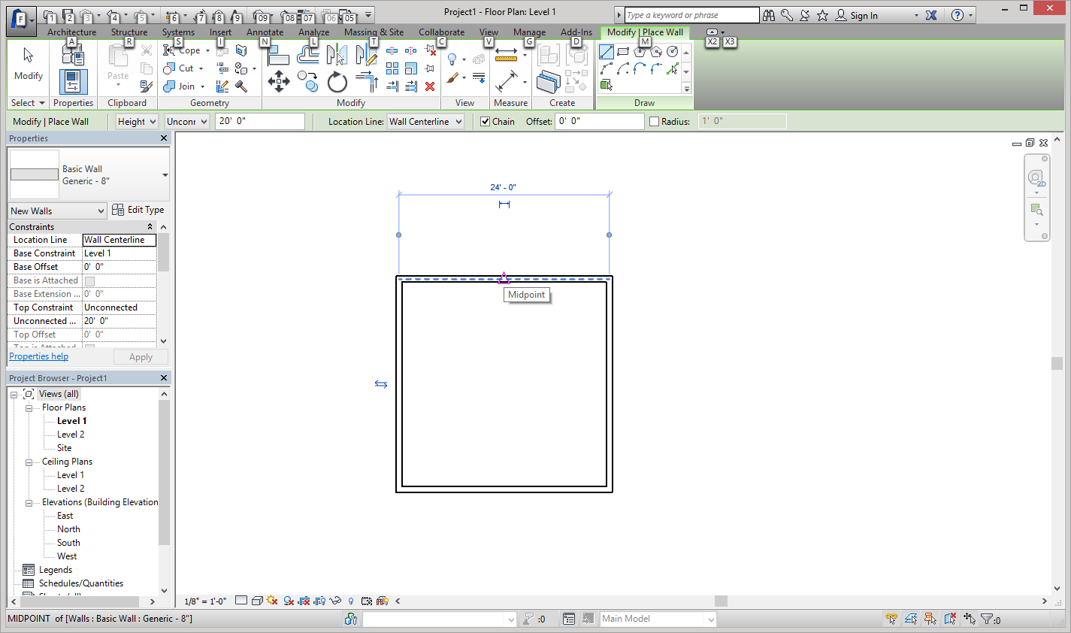
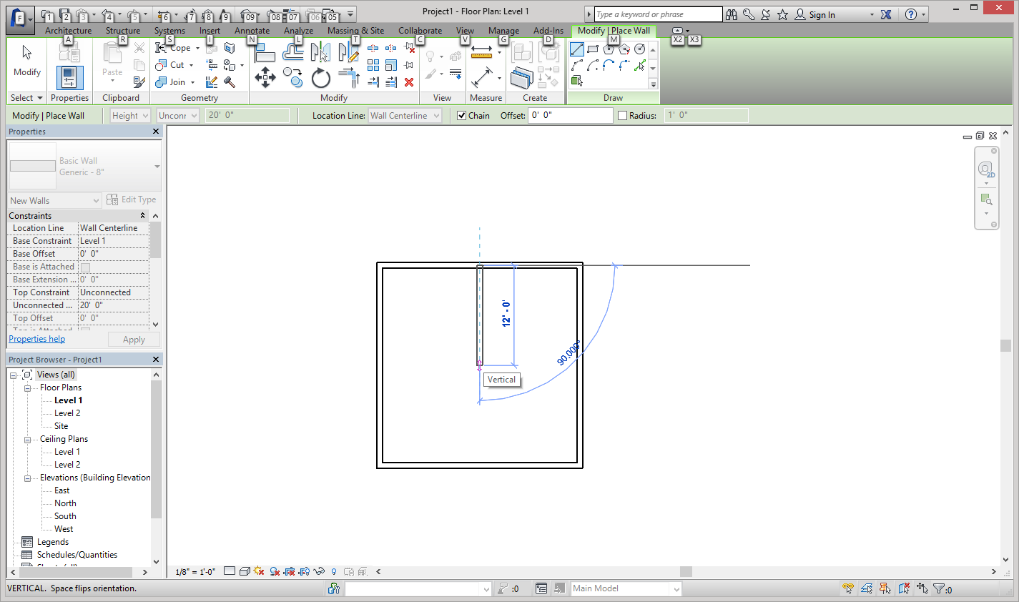
Next we are going to make a room within the cabin. The room will be 12 ft by 12 ft. Revit automatically shows you the midpoint with a small pink triangle when your mouse hovers over it.
To create the room click on the midpoint and drag your mouse down 12 feet or type 12 to get a 12 foot wall. Make sure the 90* guide appears.

Slide 6
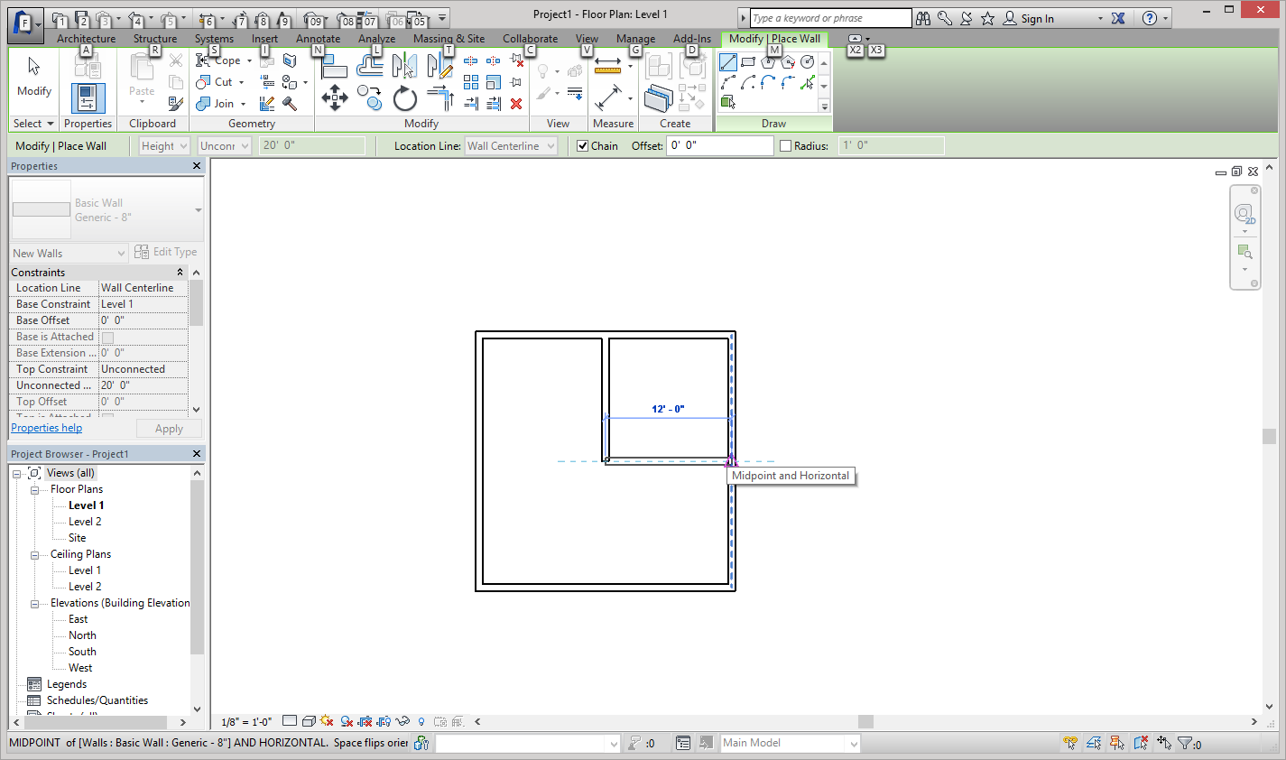
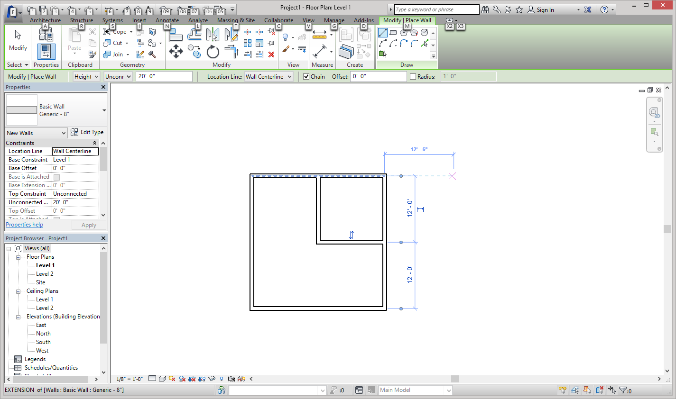
To finish the room move the mouse to the right until you reach the mid point of the East wall or type 12.
This is what your finished room should look like.

Slide 7
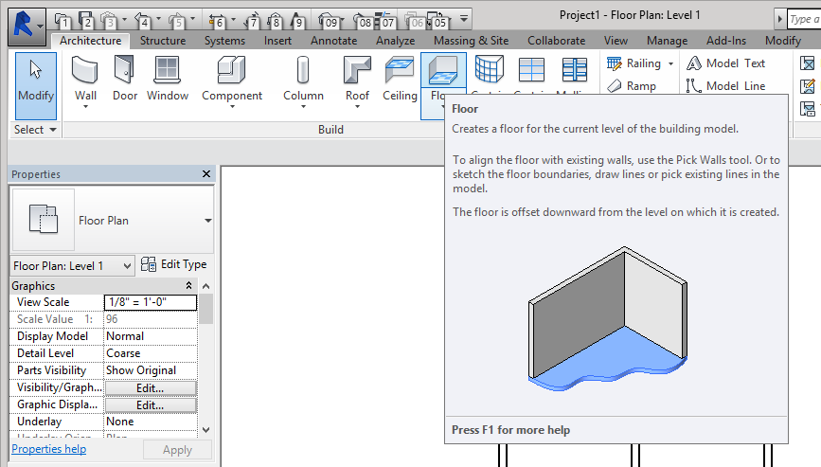
Next we will create a floor for our lovely Cabin. To exit the wall tool either press escape or select the Architecture Tab. Select the floor tool.

Slide 8
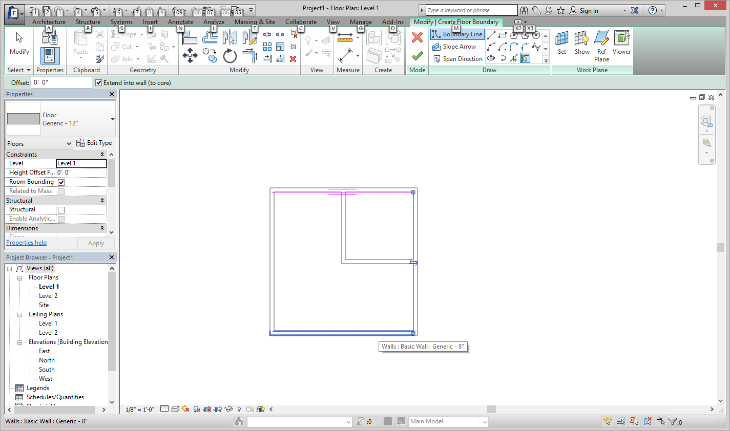
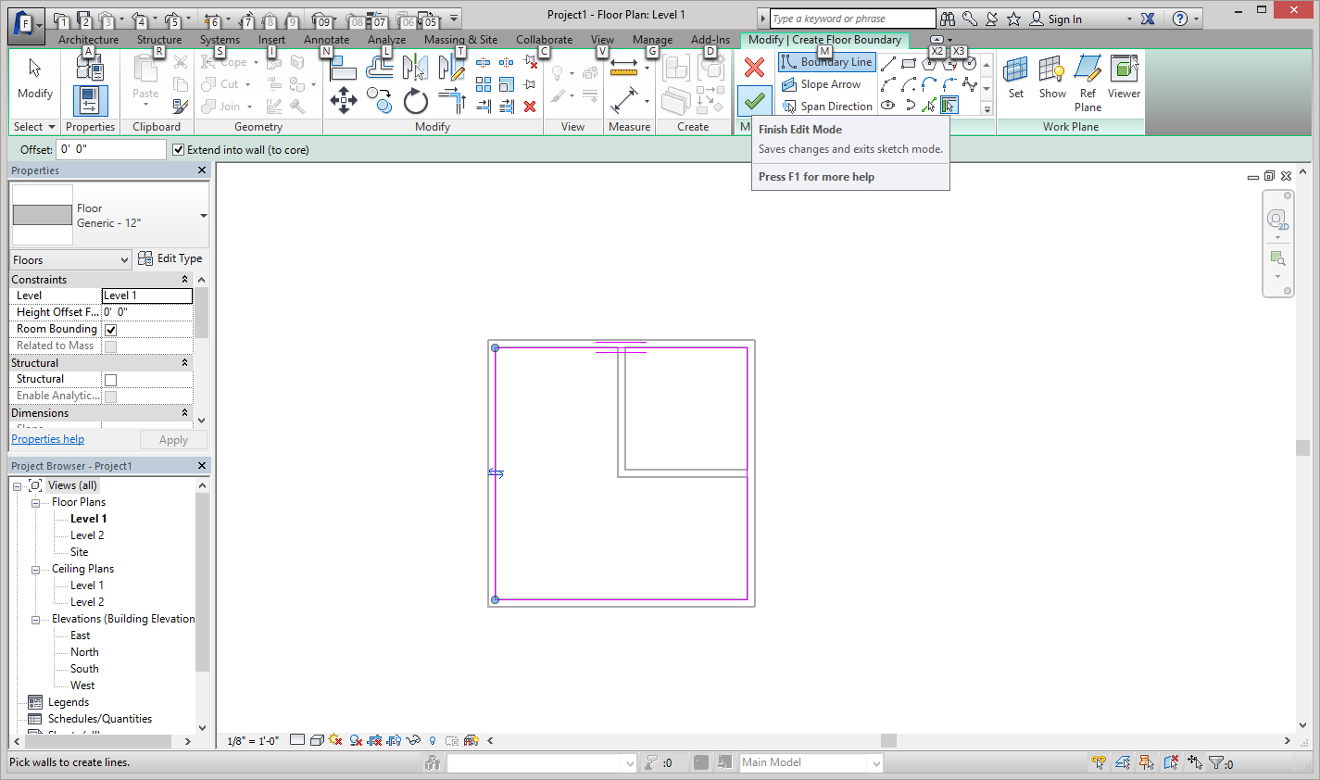
The floor tool automatically selects boundary line (options for creating floors located under the greenish Modify/ Create Floor Boundary tab. Select each wall, walls will appear blue when you move you mouse over it and turn pink when you click on them.
To create your floor, select the green check under the green Modify tab. The floor will then turn blue.

Slide 9
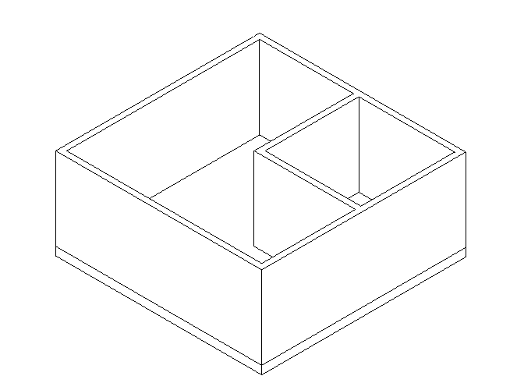
This is what your finished floor should look like.

Slide 10
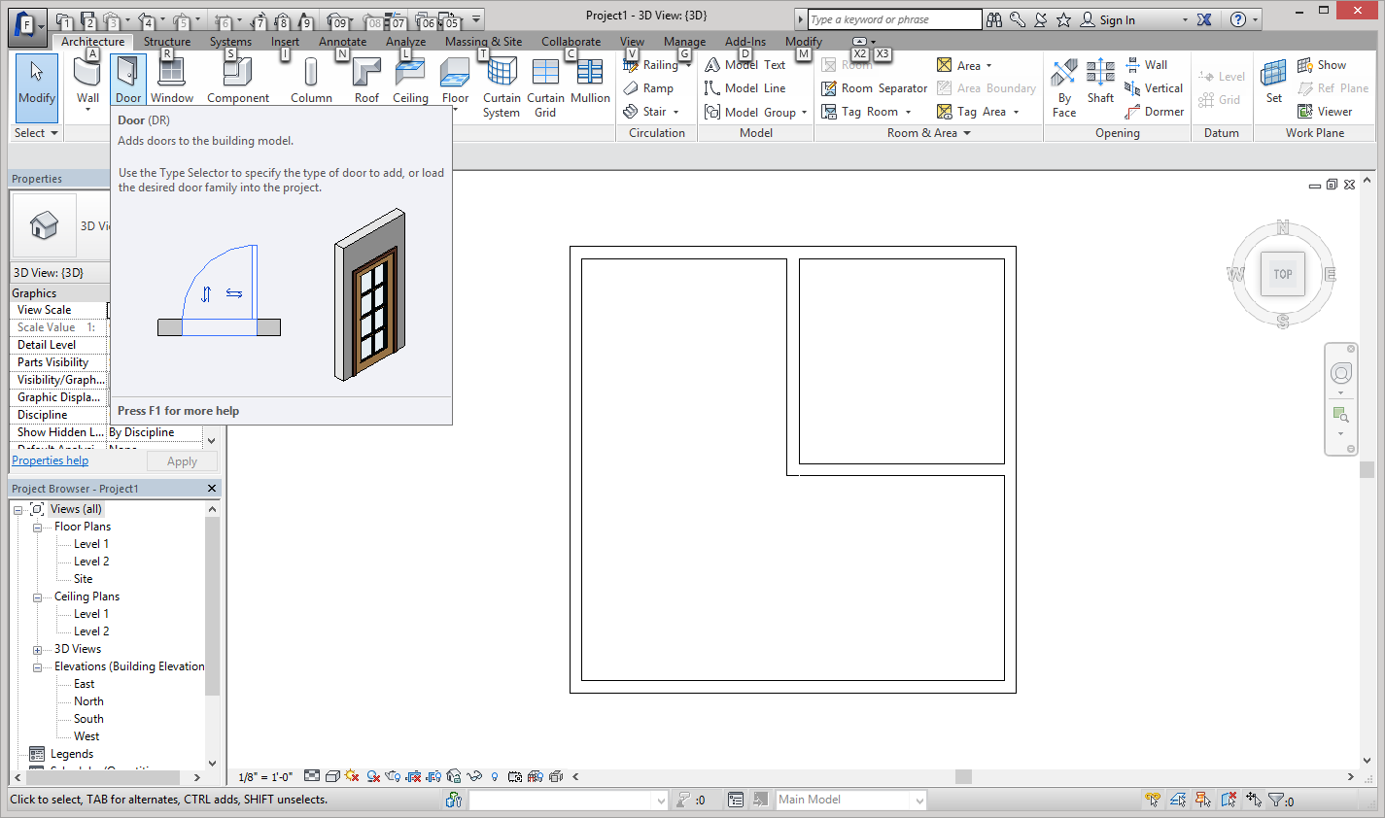
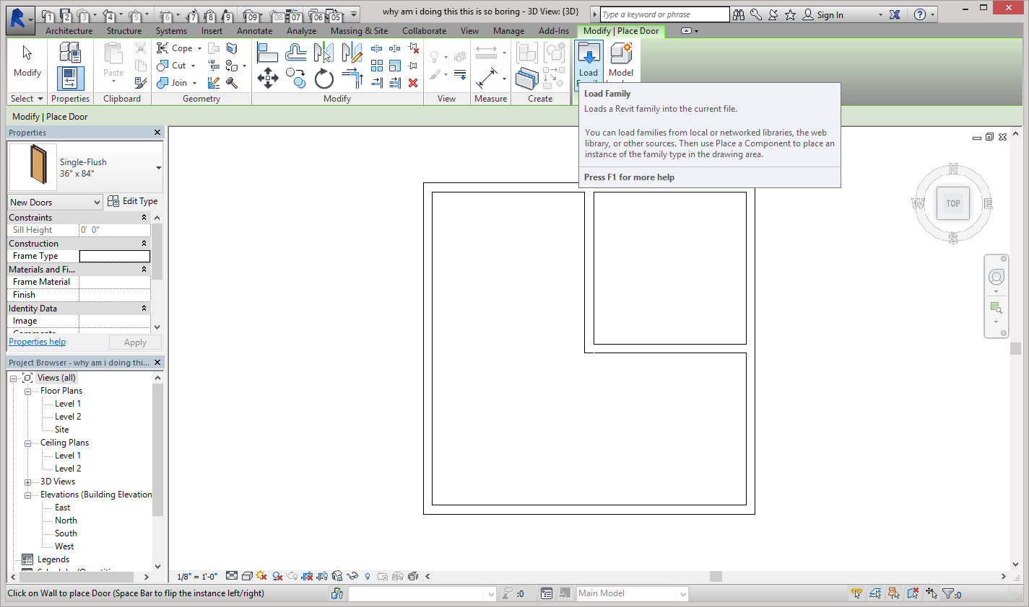
Now that we have a floor we can start adding doors and windows. First we will add doors Select the Door tool in the tool bar (ignore the weird number and letters at the top)
To find more interesting doors (if you want to, you don’t have to) select the load family and go to the doors folder.

Slide 11
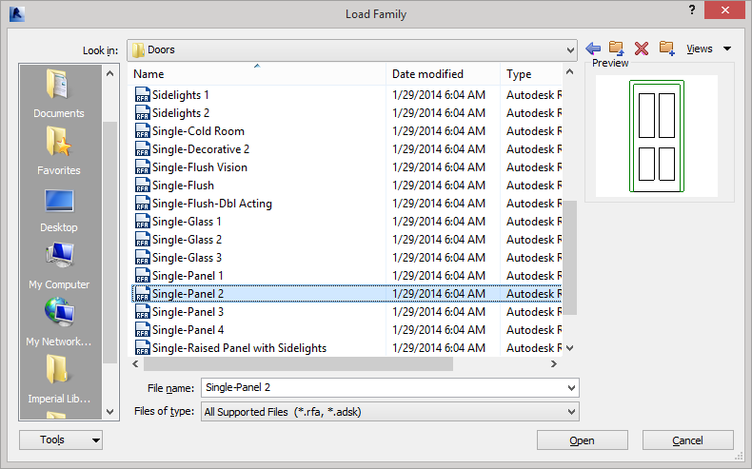
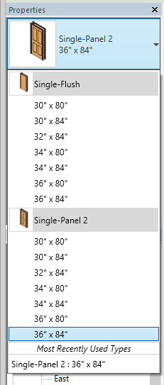
To view what the doors look like you can click on them, you have to select open to actually insert the door. (you cannot use Curtain Wall doors because we did not create curtain walls). I have chosen the Single-Panel 2 door.
If you go the Properties tab you can see the options you have for doors including the various doors you have loaded and the sizes they come in.

Slide 12
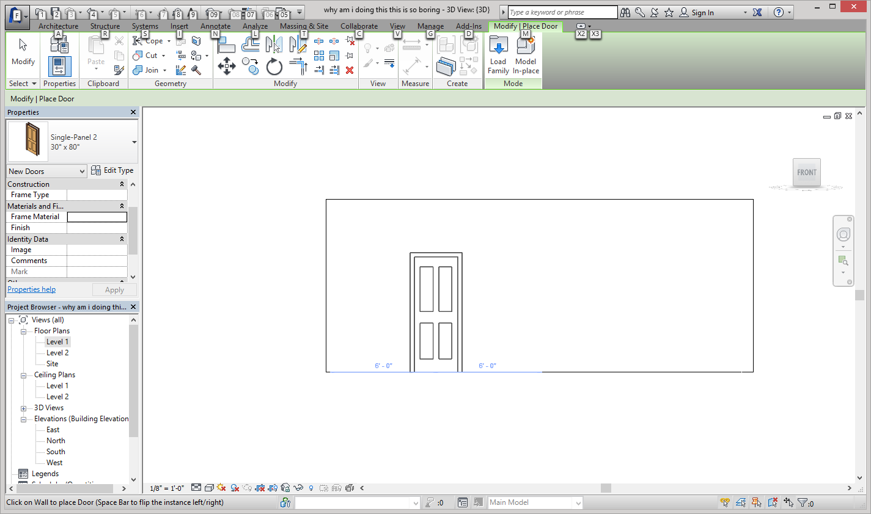
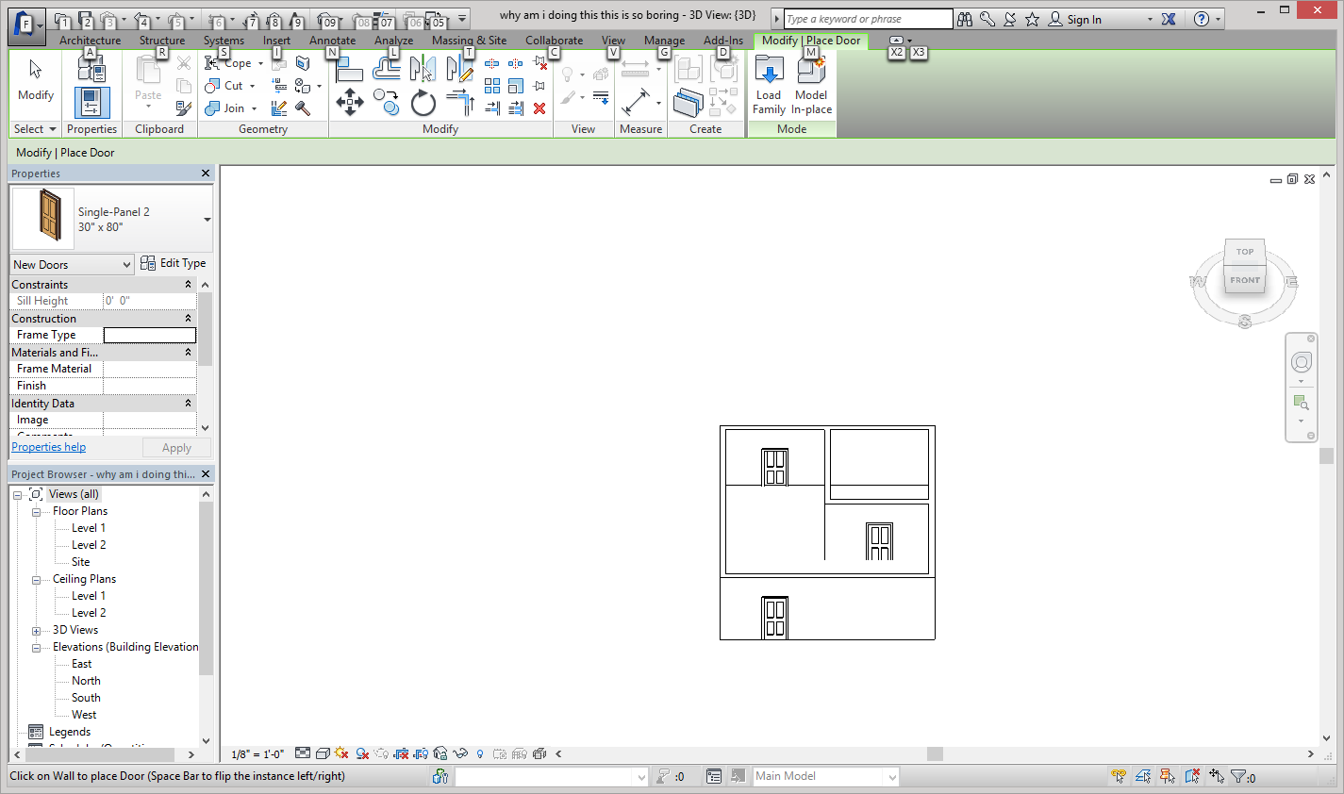
Once your door (I’m using Single-Panel 2 30” x 80”) select the front view on the magic cube of views and place the door on the south 6ft from the west wall as shown.
Add another door on the north wall 6ft feet from the west wall and one in the middle of the south interior wall.
Your cabin should look like this.

Slide 13
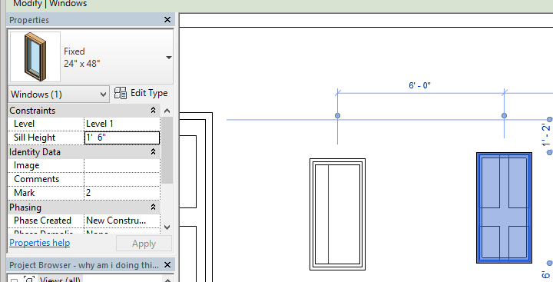
Now we get to add windows!!!! It’s so exciting I know. To add windows select modify in the upper left hand corner of your screen and then select window.
I am going to be using the fixed window size 24” x 48”. Insert two windows on the south wall, one 6ft right of the door and another 6ft to the left of the east wall. All other windows are 6ft away from the wall and each other.

Slide 14
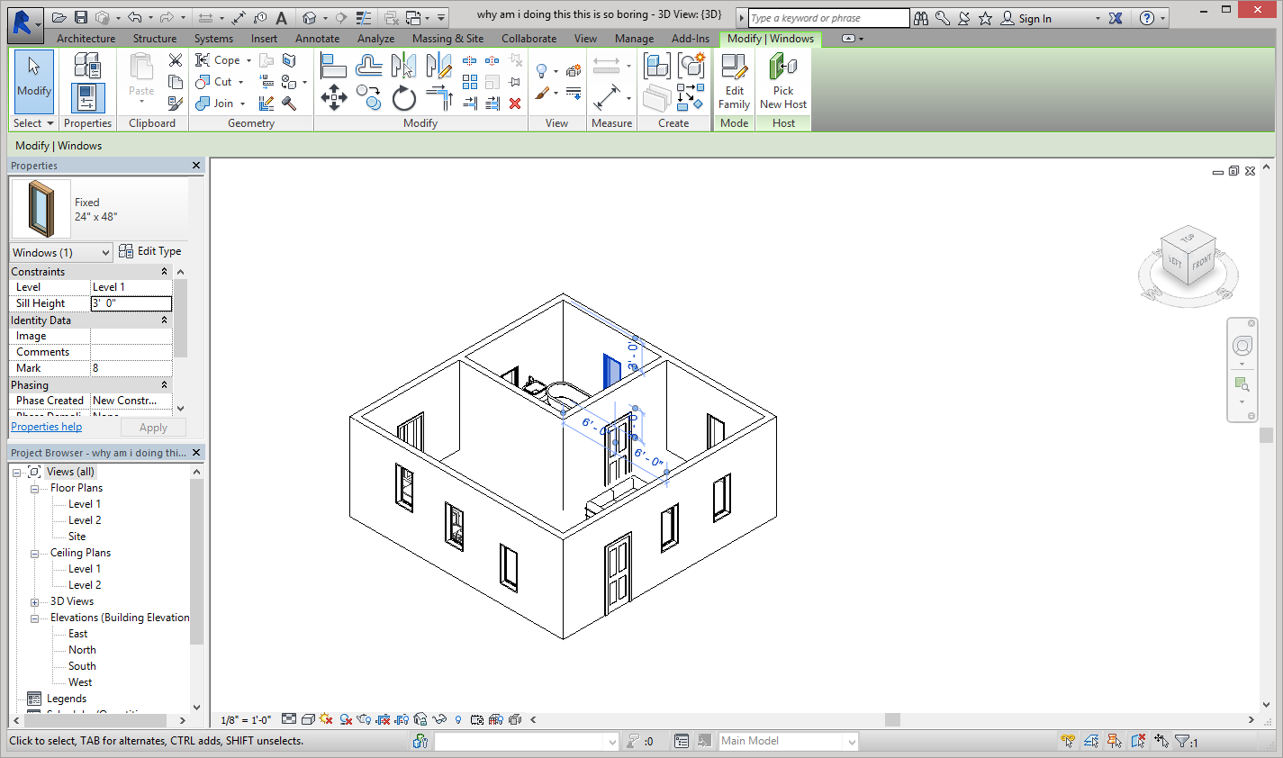
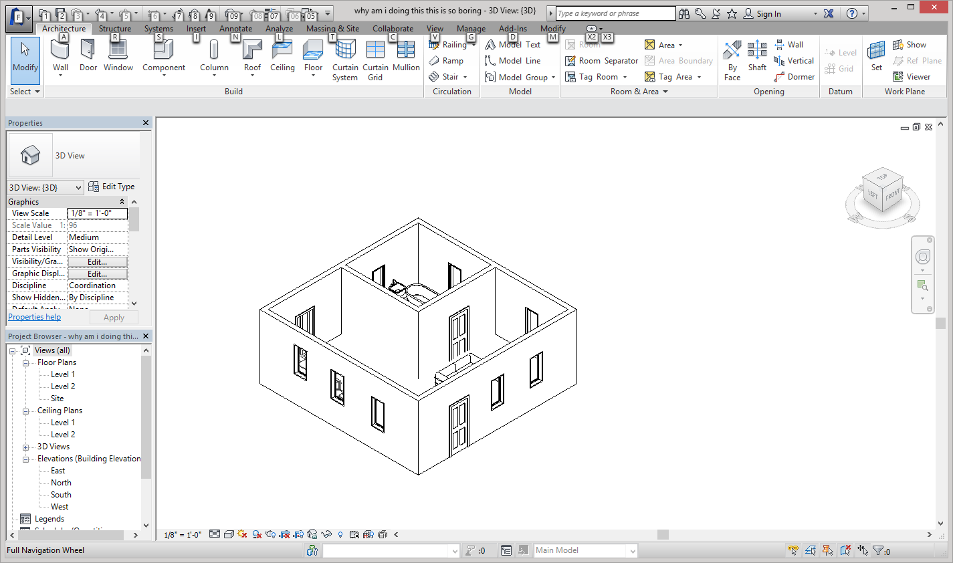
Sometimes you can adjust the sill height when you are inserting the windows, but if you don’t, select the window (to select multiple windows hold down the shift key and select the windows) and under properties you can change the sill height. I made my sill height 3ft.
This is what your cabin should look like after you insert all of the windows. You cannot add a window in the middle of the north and east walls as it interferes with the interior walls.

Slide 15
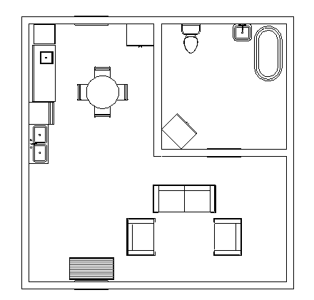
Now we add furniture. I am going to do my own design for this, you can do whatever you want. To find all of the various furniture, go to component then load family.
To find living room/bedroom furniture- go to the furniture folder.
To find bathroom fixtures- go to plumbing, architectural, then fixtures.
For kitchen/laundry room stuff- plumbing, MEP, fixtures, appliances.
If you want to rotate components, press the space bar.
If you want to move them up or down the wall, select the component and go to offset under properties.

Slide 16
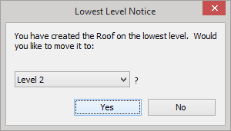
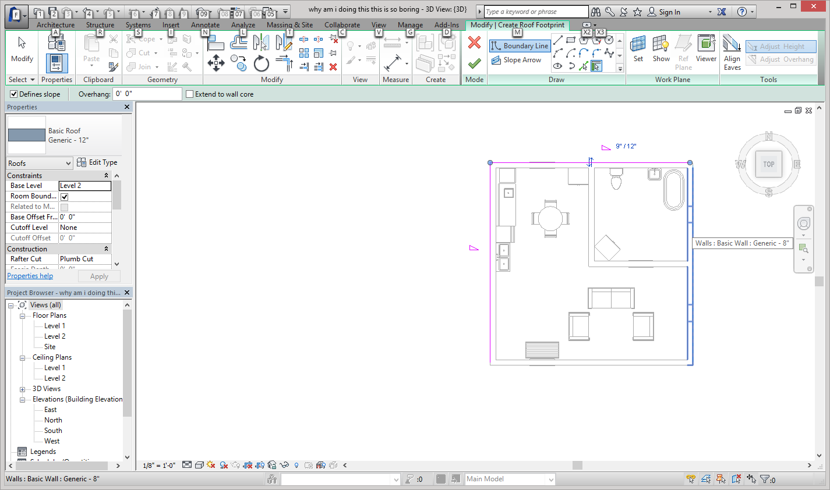
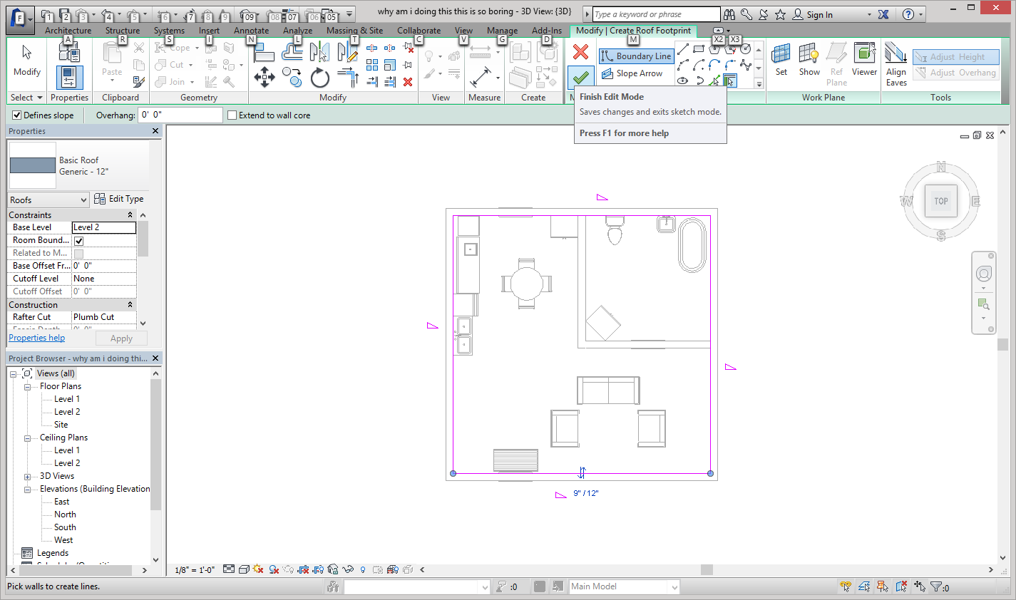
For the final step, we are going to put on a basic roof by footprint. This isn’t the only type of roof but you will learn about others later. Start by selecting the roof tool under the architecture tab. You will want to create the roof on the lowest level.
Next, simply select all of the exterior walls. (the pink walls have already been selected) then click the big green check at the top of the page.

Slide 17
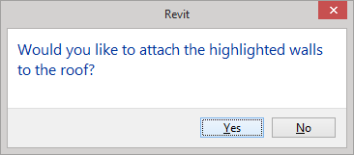
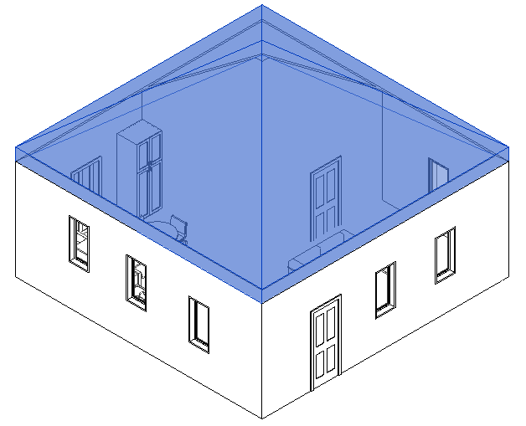
You want to attach the high lighted walls (the interior walls) to the roof as well. Also fun fact the pink line should be on the outside of the house otherwise the roof doesn’t work. If you view the roof now when it’s blue you can see that the interior walls now reach the roof.
Now you have a completed cabin!

Slide 18
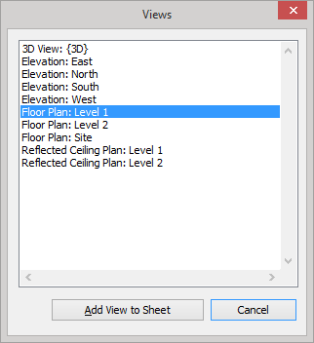
Just because you completed the cabin doesn’t mean you have completed the assignment! You now have to print it ☺.
First go to the view tab and select sheet (to the right of your screen) You DO NOT want to print on an E sized sheet. Select load in the upper right hand corner of the window then go to Titleblocks in the Project Browser. You will want the A sized sheet.
Next you need to drag your views onto the sheet. Select the View button under the sheet button and select the first floor view. (Make sure to activate the view otherwise the next step won’t work.)

Slide 19
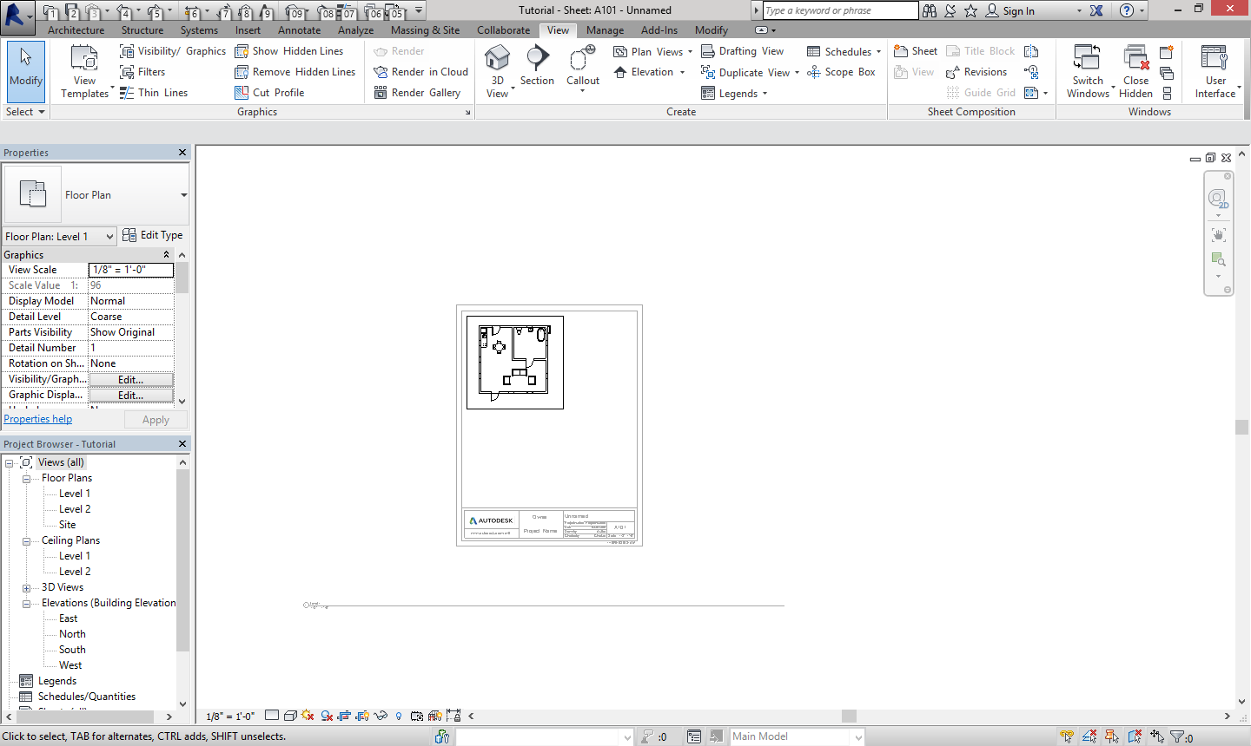
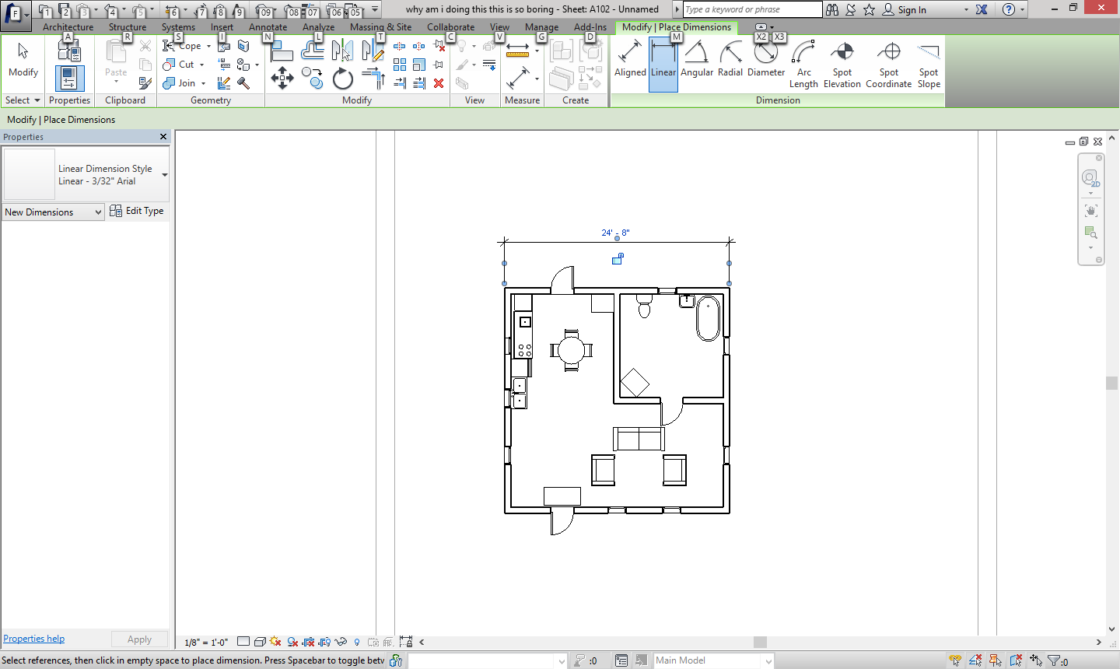
You will want to crop the view down. Go to the bottom of your page and select show crop region, you may need to zoom out for this. The select the crop tool directly to the left to crop down the view. You then need to drag that little line that says Level One beneath the drawing.
You will need to add in dimensions. Go to the annotate tab and select linear. Select the outer walls on the top and right to provide too dimensions. Then dimension the inside room.
Then fill in the title block with your name and the project.
If you look to the left under sheet properties you will see a scale. We are using 1/8” = 1’ lay around with them if you wish. It will help you print other views.

Slide 20
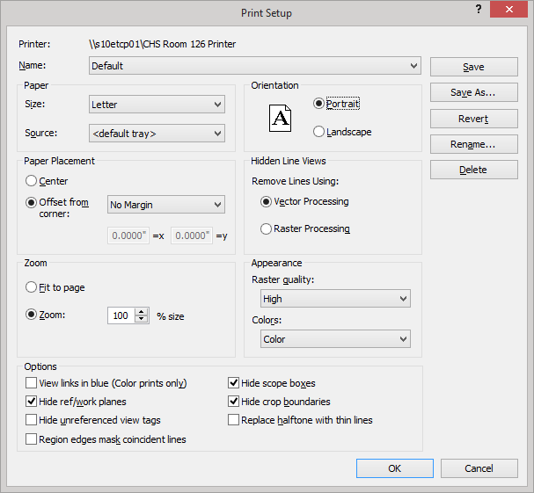
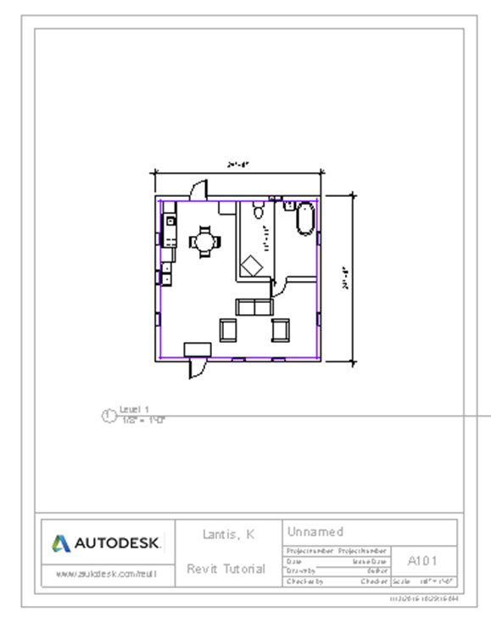
The sheets are set up to print kind of weird which means you have to change the settings. Under the R in the upper left hand corner and find print settings (under print) and make sure you are printing Portrait and the Zoom is set to 100%.
This is what your printed view should look like.

Slide 21
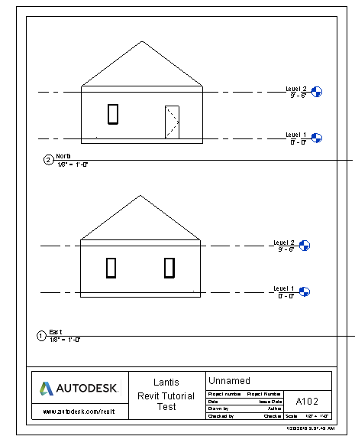
Oh you thought we were done didn’t you? You were wrong. You now have to print the four elevation views. Depending on the size you can either put two on one page or just have one per page.
Go to the view tab and select a new sheet.
After selecting a new sheet add the views onto the sheet like you did with the floor plan. Here is an example of how I did the views.

Slide 22
AND NOW YOU’RE DONE!!!

